Slide 1
Spack: Package Management for HPC
Todd Gamblin
(he/him)
Senior Principal Member of Technical Staff Lawrence Livermore National Laboratory
ATPESC 2022 Software Track

Slide 2

HPC simulations rely on icebergs of dependency libraries
MFEM: Higher-order finite elements
31 packages,
69 dependency edges
LBANN: Neural Nets for HPC
71 packages
188 dependency edges
MuMMI: Cancer/drug interaction modeling
Integrates MD , HPC scheduling, ML
98 packages
248 dependency edges

Slide 3
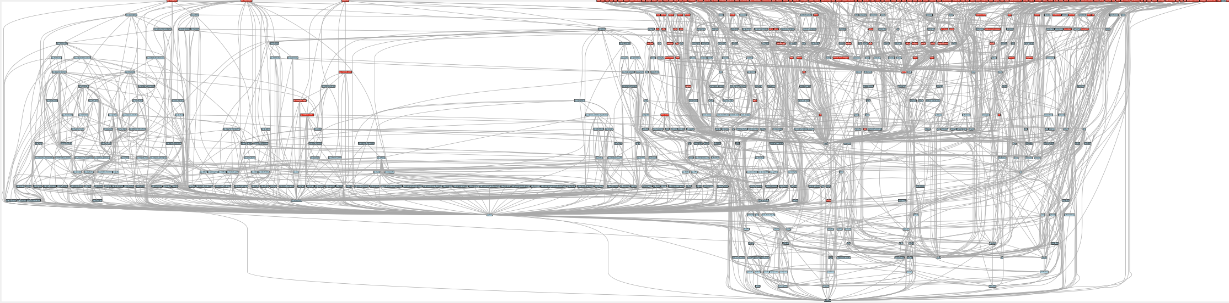
ECP’s E4S stack is even larger than these codes
Red boxes are the packages in it (about 100)
Blue boxes are what else you need to build it (about 600)
It’s infeasible to build and integrate all of this manually

Slide 4
Some fairly common (but questionable) assumptions made by package managers (conda, pip, apt, etc.)
1:1 relationship between source code and binary (per platform)
Good for reproducibility (e.g., Debian)
Bad for performance optimization
Binaries should be as portable as possible
What most distributions do
Again, bad for performance
Toolchain is the same across the ecosystem
One compiler, one set of runtime libraries
Or, no compiler (for interpreted languages)
Outside these boundaries, users are typically on their own

Slide 5
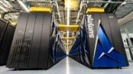
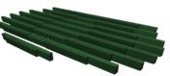

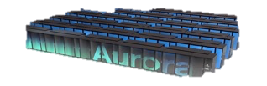

High Performance Computing (HPC) violates many of these assumptions
Some Supercomputers
Summit
Fugaku
Code is typically distributed as source
With exception of vendor libraries, compilers
Often build many variants of the same package
Developers’ builds may be very different
Many first-time builds when machines are new
Code is optimized for the processor and GPU
Must make effective use of the hardware
Can make 10-100x perf difference
Rely heavily on system packages
Need to use optimized libraries that come with machines
Need to use host GPU libraries and network
Multi-language
C, C++, Fortran, Python, others all in the same ecosystem
Oak Ridge National Lab
Power9 / NVIDIA
RIKEN
Fujitsu/ARM a64fx
Current
NERSC-9
Perlmutter
Lawrence Berkeley National Lab
AMD Zen / NVIDIA
Oak Ridge National Lab
AMD Zen / Radeon
Aurora
Upcoming
Argonne National Lab
Intel Xeon / Xe
Lawrence Livermore National Lab AMD Zen / Radeon

Slide 6
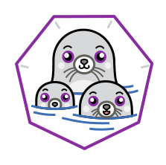




What about containers?
Containers provide a great way to reproduce and distribute an already-built software stack
Someone needs to build the container!
This isn’t trivial
Containerized applications still have hundreds of dependencies
Using the OS package manager inside a container is insufficient
Most binaries are built unoptimized
Generic binaries, not optimized for specific architectures
HPC containers may need to be rebuilt to support many different hosts, anyway.
Not clear that we can ever build one container for all facilities
Containers likely won’t solve the N-platforms problem in HPC
We need something more flexible to build the containers

Slide 7
Spack enables Software distribution for HPC
Spack automates the build and installation of scientific software
Packages are parameterized, so that users can easily tweak and tune configuration
Ease of use of mainstream tools, with flexibility needed for HPC
In addition to CLI, Spack also:
Generates (but does not require) modules
Allows conda/virtualenv-like environments
Provides many devops features (CI, container generation, more)
No installation required: clone and go
$ git clone https://github.com/spack/spack
$ spack install hdf5
Simple syntax enables complex installs
$ spack install hdf5@1.10.5
$ spack install hdf5@1.10.5 %clang@6.0
$ spack install hdf5@1.10.5 +threadssafe
$ spack install hdf5@1.10.5 cppflags="-O3 –g3"
$ spack install hdf5@1.10.5 target=haswell
$ spack install hdf5@1.10.5 +mpi ^mpich@3.2
github.com/spack/spack

Slide 8
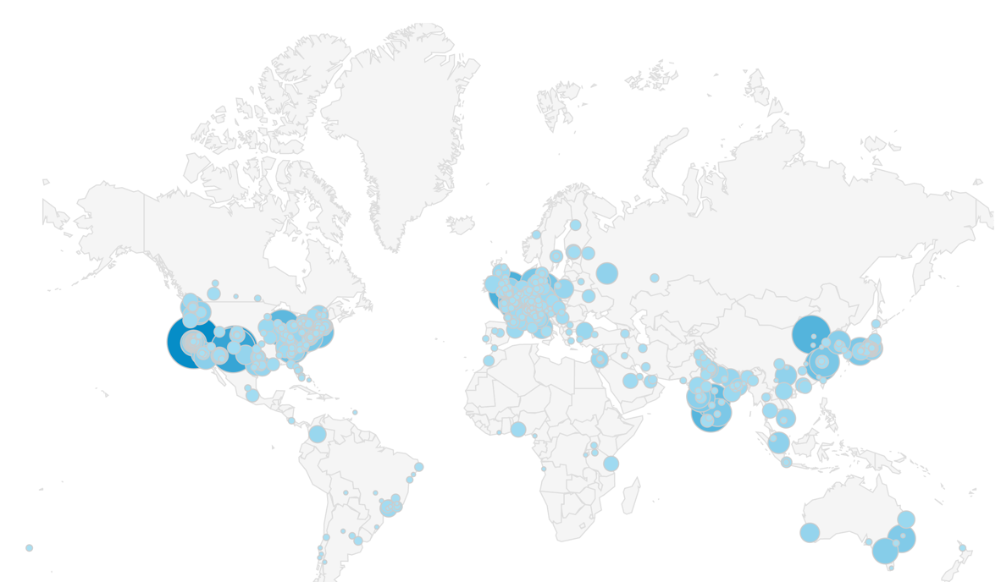
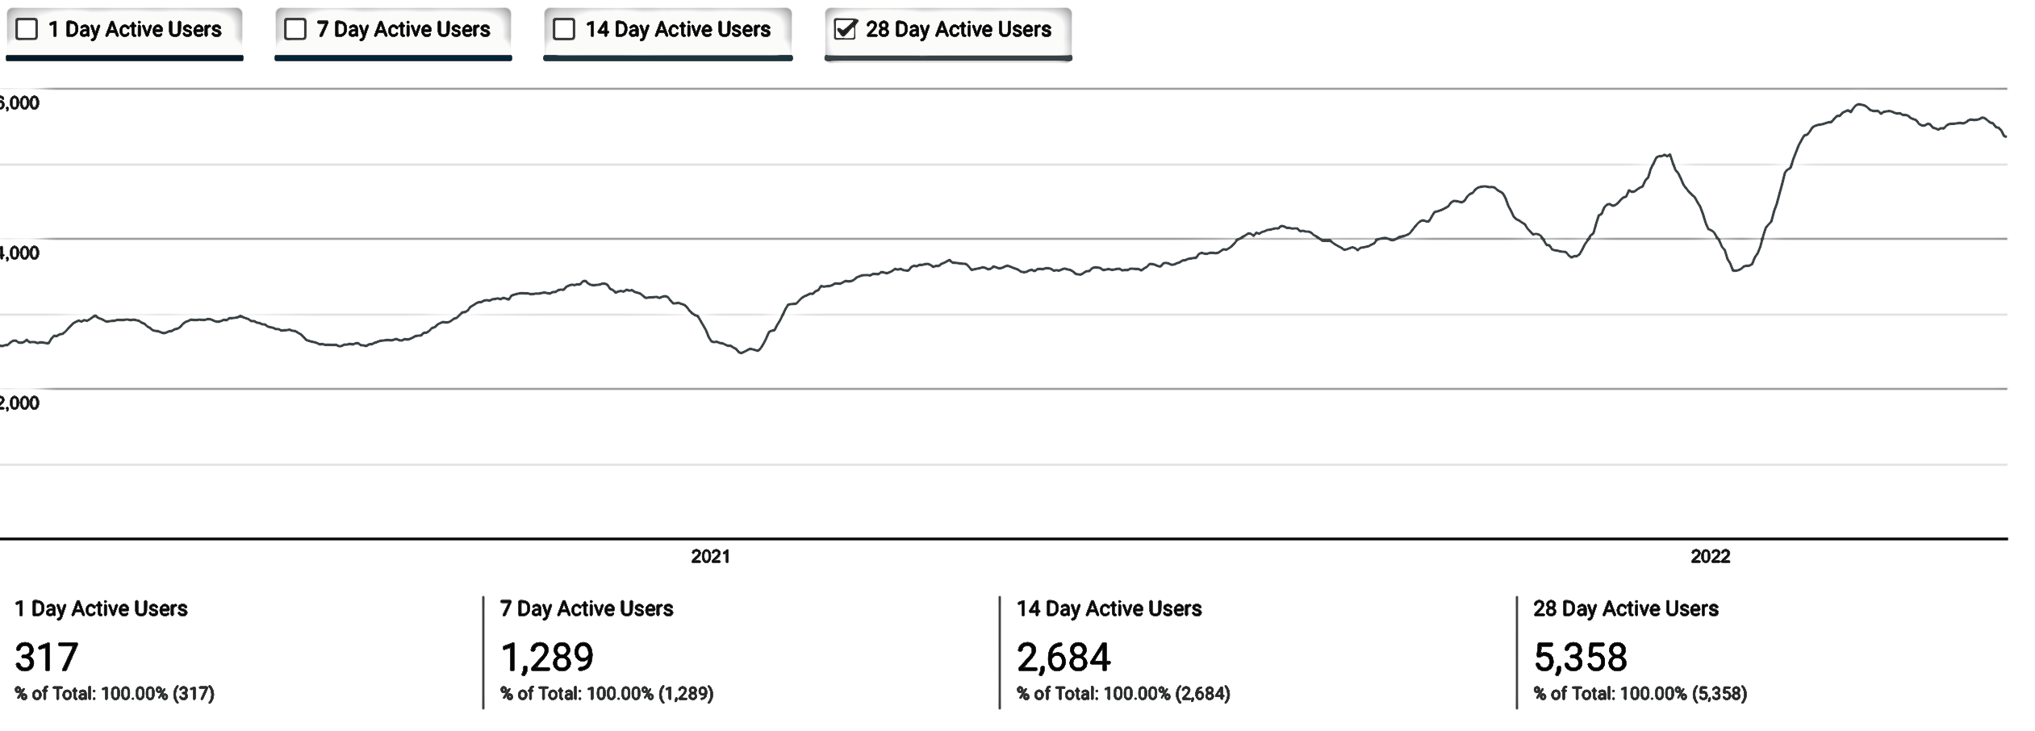
Spack sustains the HPC software ecosystem with the help of its many contributors
6,400+ software packages
Over 1,000 contributors
Most package contributions are not from DOE!
Monthly active users
Nearly 6,000 monthly active users (per documentation site)

Slide 9
Spack provides a spec syntax to describe customized installations
$ spack install mpileaks unconstrained
$ spack install mpileaks@3.3 @ custom version
$ spack install mpileaks@3.3 %gcc@4.7.3 % custom compiler
$ spack install mpileaks@3.3 %gcc@4.7.3 +threads +/- build option
$ spack install mpileaks@3.3 cppflags="-O3 –g3" set compiler flags
$ spack install mpileaks@3.3 target=zen2 set target microarchitecture
$ spack install mpileaks@3.3 ^mpich@3.2 %gcc@4.9.3 ^ dependency information
Each expression is a spec for a particular configuration
Each clause adds a constraint to the spec
Constraints are optional – specify only what you need.
Customize install on the command line!
Spec syntax is recursive
Full control over the combinatorial build space

Slide 10
Spack packages are templates They use a simple Python DSL to define how to build
Not shown: patches, resources, conflicts, other directives.
from spack import *
class Kripke(CMakePackage):
"""Kripke is a simple, scalable, 3D Sn deterministic particle
transport proxy/mini app.
"""
homepage = "https://computation.llnl.gov/projects/co-design/kripke"
url = "https://computation.llnl.gov/projects/co-design/download/kripke-openmp-1.1.tar.gz"
version(‘1.2.3’, sha256='3f7f2eef0d1ba5825780d626741eb0b3f026a096048d7ec4794d2a7dfbe2b8a6’)
version(‘1.2.2’, sha256='eaf9ddf562416974157b34d00c3a1c880fc5296fce2aa2efa039a86e0976f3a3’)
version('1.1’, sha256='232d74072fc7b848fa2adc8a1bc839ae8fb5f96d50224186601f55554a25f64a’)
variant('mpi', default=True, description='Build with MPI.’)
variant('openmp', default=True, description='Build with OpenMP enabled.’)
depends_on('mpi', when='+mpi’)
depends_on('cmake@3.0:', type='build’)
def cmake_args(self):
return [
'-DENABLE_OPENMP=%s’ % ('+openmp’ in self.spec),
'-DENABLE_MPI=%s' % ('+mpi’ in self.spec),
]
def install(self, spec, prefix):
# Kripke does not provide install target, so we have to copy
# things into place.
mkdirp(prefix.bin)
install('../spack-build/kripke', prefix.bin)
Base package
(CMake support)
Metadata at the class level
Versions
Variants (build options)
Dependencies (same spec syntax)
Install logic in instance methods
Don’t typically need install() for CMakePackage, but we can work around codes that don’t have it.

Slide 11
Concretization fills in missing configuration details when the user is not explicit.
mpileaks ^callpath@1.0+debug ^libelf@0.8.11
User input: abstract spec with some constraints
spec.yaml
spec:
- mpileaks:
arch: linux-x86_64
compiler:
name: gcc
version: 4.9.2
dependencies:
adept-utils: kszrtkpbzac3ss2ixcjkcorlaybnptp4
callpath: bah5f4h4d2n47mgycej2mtrnrivvxy77
mpich: aa4ar6ifj23yijqmdabeakpejcli72t3
hash: 33hjjhxi7p6gyzn5ptgyes7sghyprujh
variants: {}
version: '1.0'
- adept-utils:
arch: linux-x86_64
compiler:
name: gcc
version: 4.9.2
dependencies:
boost: teesjv7ehpe5ksspjim5dk43a7qnowlq
mpich: aa4ar6ifj23yijqmdabeakpejcli72t3
hash: kszrtkpbzac3ss2ixcjkcorlaybnptp4
variants: {}
version: 1.0.1
- boost:
arch: linux-x86_64
compiler:
name: gcc
version: 4.9.2
dependencies: {}
hash: teesjv7ehpe5ksspjim5dk43a7qnowlq
variants: {}
version: 1.59.0
...
Normalize
Concretize
Store
Abstract, normalized spec
with some dependencies
Concrete spec is fully constrained
and can be passed to install
Detailed provenance stored
with installed package

Slide 12
Spack handles combinatorial software complexity
Each unique dependency graph is a unique configuration.
Each configuration in a unique directory.
Multiple configurations of the same package can coexist.
Hash of entire directed acyclic graph (DAG) is appended to each prefix.
Installed packages automatically find dependencies
Spack embeds RPATHs in binaries.
No need to use modules or set LD_LIBRARY_PATH
Things work the way you built them
Dependency DAG
Installation Layout
Hash
opt
└── spack
├── darwin-mojave-skylake
│ └── clang-10.0.0-apple
│ ├── bzip2-1.0.8-hc4sm4vuzpm4znmvrfzri4ow2mkphe2e
│ ├── python-3.7.6-daqqpssxb6qbfrztsezkmhus3xoflbsy
│ ├── sqlite-3.30.1-u64v26igxvxyn23hysmklfums6tgjv5r
│ ├── xz-5.2.4-u5eawkvaoc7vonabe6nndkcfwuv233cj
│ └── zlib-1.2.11-x46q4wm46ay4pltriijbgizxjrhbaka6
├── darwin-mojave-x86_64
│ └── clang-10.0.0-apple
│ └── coreutils-8.29-pl2kcytejqcys5dzecfrtjqxfdssvnob
opt
└── spack
├── darwin-mojave-skylake
│ └── clang-10.0.0-apple
│ ├── bzip2-1.0.8-hc4sm4vuzpm4znmvrfzri4ow2mkphe2e
│ ├── python-3.7.6-daqqpssxb6qbfrztsezkmhus3xoflbsy
│ ├── sqlite-3.30.1-u64v26igxvxyn23hysmklfums6tgjv5r
│ ├── xz-5.2.4-u5eawkvaoc7vonabe6nndkcfwuv233cj
│ └── zlib-1.2.11-x46q4wm46ay4pltriijbgizxjrhbaka6
├── darwin-mojave-x86_64
│ └── clang-10.0.0-apple
│ └── coreutils-8.29-pl2kcytejqcys5dzecfrtjqxfdssvnob

Slide 13
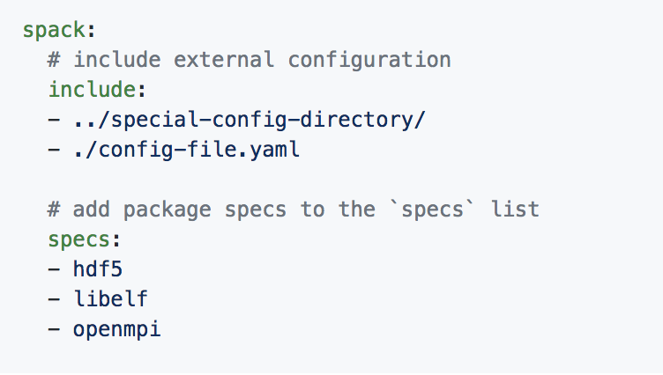
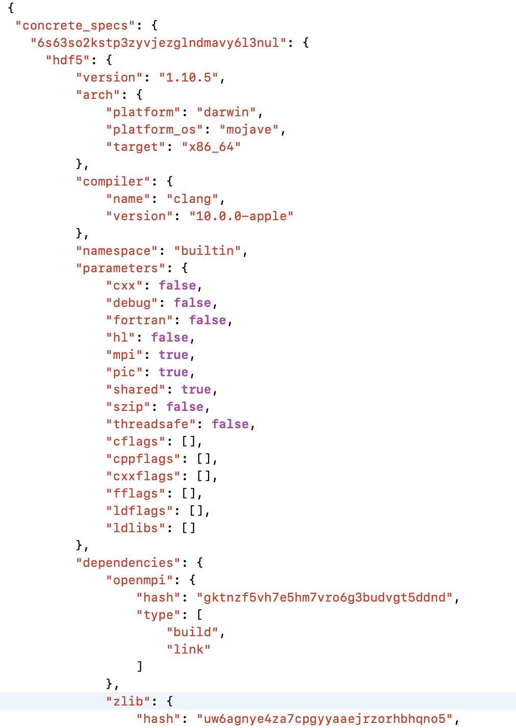
Spack environments enable users to build customized stacks from an abstract description
Simple spack.yaml file
Dependency packages
install
build project
spack.yaml file with names of required dependencies
Lockfile describes exact versions installed
spack.yaml describes project requirements
spack.lock describes exactly what versions/configurations were installed, allows them to be reproduced.
Can also be used to maintain configuration together with Spack packages.
E.g., versioning your own local software stack with consistent compilers/MPI implementations
Allows developers and site support engineers to easily version Spack configurations in a repository
Concrete spack.lock file (generated)

Slide 14
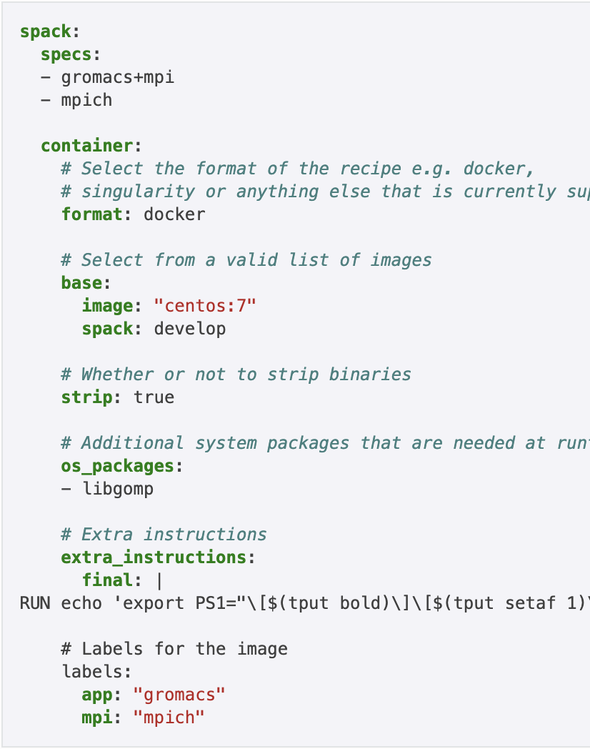
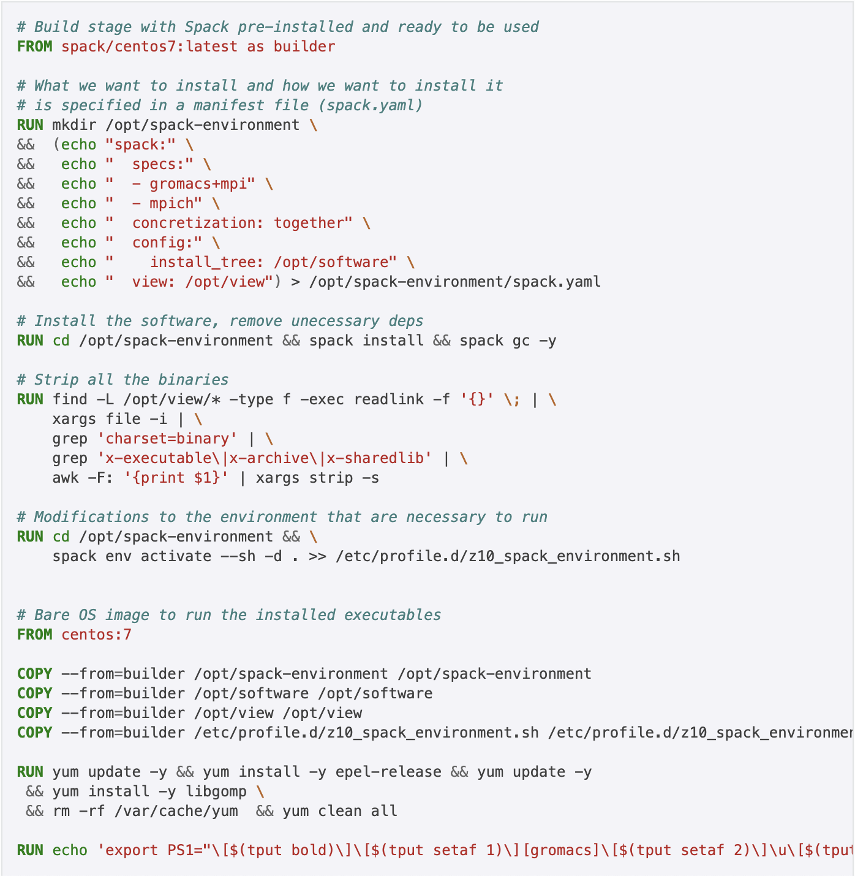

Spack can generate multi-stage container build recipes
Any Spack environment can be bundled into a container image
Optional container section allows finer-grained customization
Generated Dockerfile uses multi-stage builds to minimize size of final image
Strips binaries
Removes unneeded build deps with spack gc
Can also generate Singularity recipes
spack containerize

Slide 15
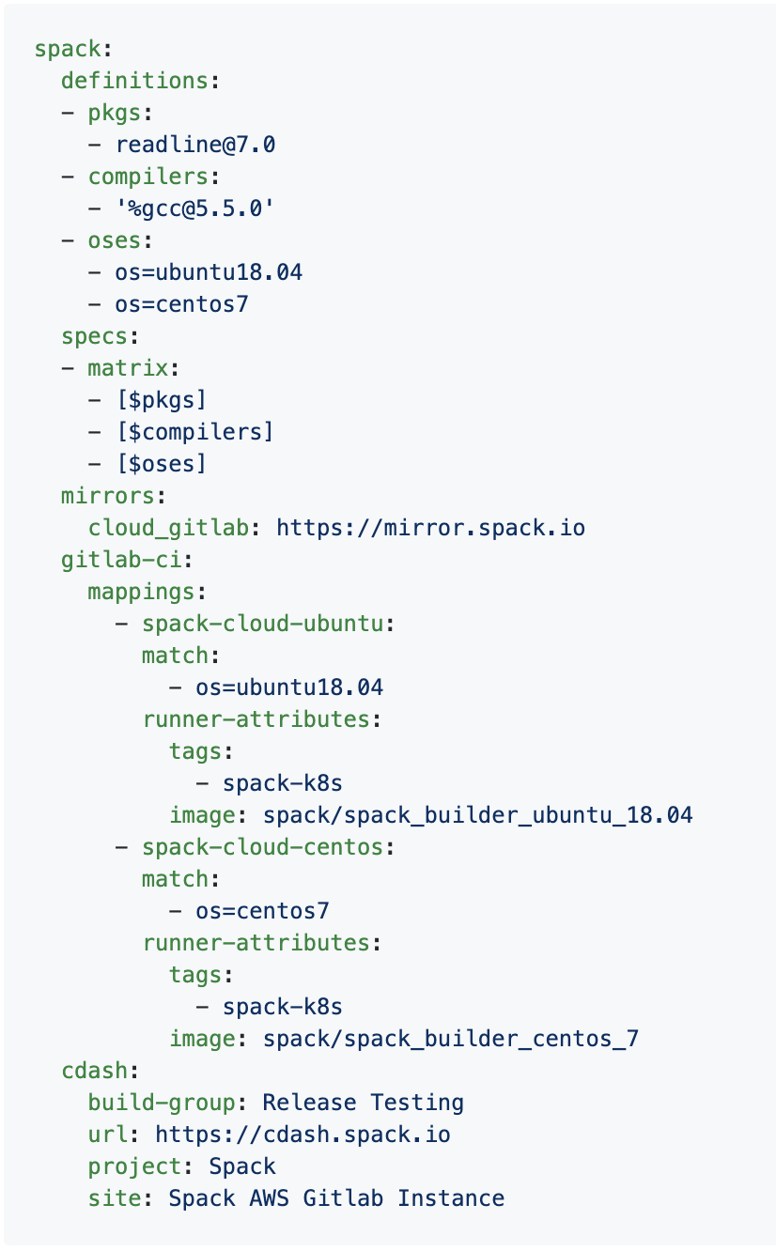
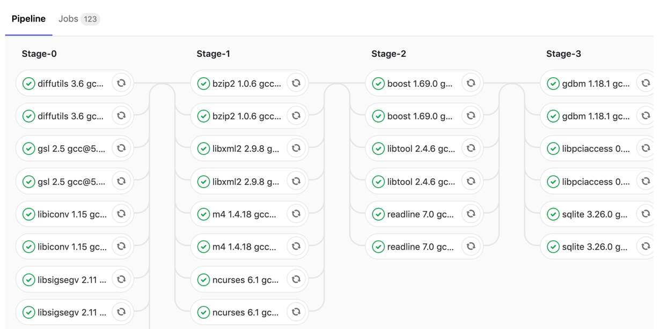

Spack has GitLab CI integration to automate package build pipelines
Builds on Spack environments
Support auto-generating GitLab CI jobs
Can run in a Kube cluster or on bare metal runners at an HPC site
Sends progress to CDash

Slide 16
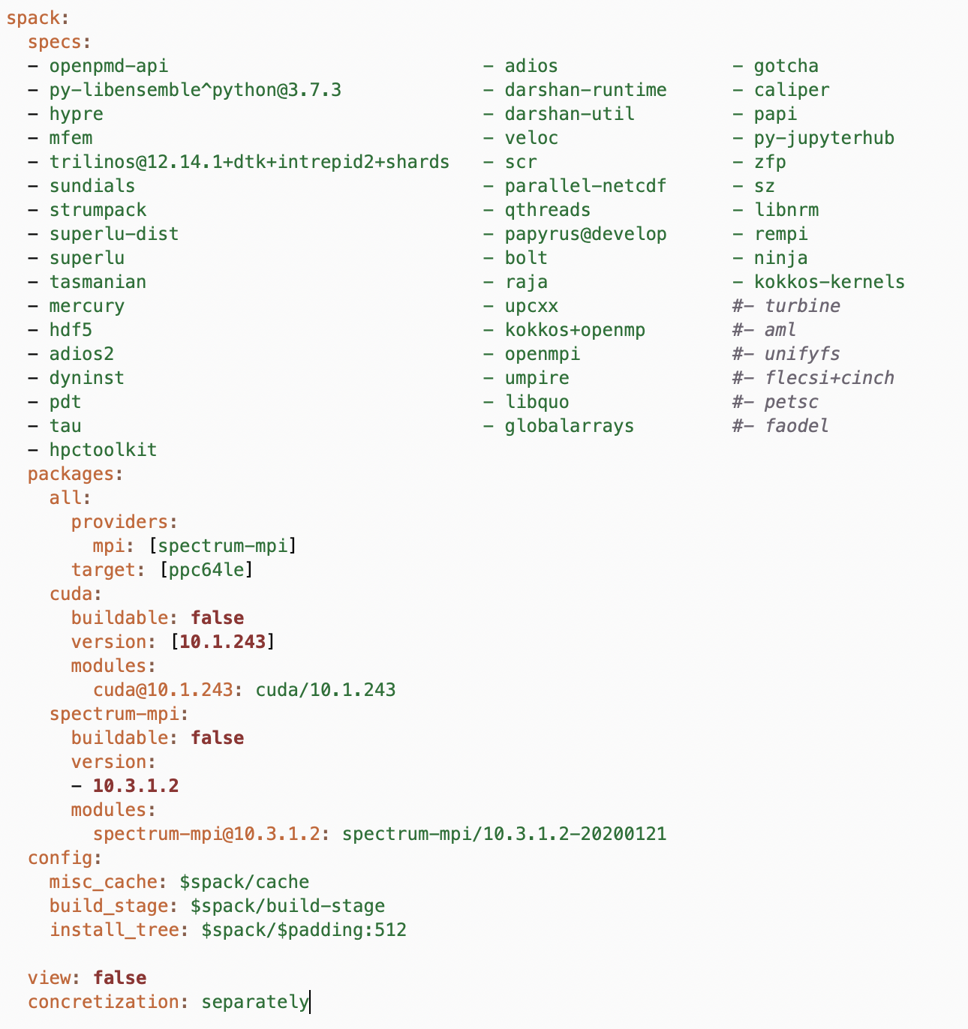
E4S is ECP’s curated, Spack-based software distribution
E4S is just a set of Spack packages
60+ packages (297 including dependencies)
Growing to include all of ST and more
Users can install E4S packages:
In their home directory
In a container
Facilities can install E4S packages:
On bare metal
In a container
Users and facilities can choose parts they want
spack install only the packages you want
Or just edit the list of packages (and configurations) you want in a spack.yaml file
E4S manifest (spack.yaml)
More on E4S at https://e4s.io

Slide 17
spack test: write tests directly in Spack packages, so that they can evolve with the software
Tests are part of a regular Spack recipe class
class Libsigsegv(AutotoolsPackage, GNUMirrorPackage):
"""GNU libsigsegv is a library for handling page faults in user mode."""
# ... spack package contents ...
extra_install_tests = ‘tests/.libs’
def test(self):
data_dir = self.test_suite.current_test_data_dir
smoke_test_c = data_dir.join(‘smoke_test.c’)
self.run_test(
'cc’, [
'-I%s' % self.prefix.include,
'-L%s' % self.prefix.lib, '-lsigsegv’,
smoke_test_c,
'-o', 'smoke_test'
]
purpose='check linking’)
self.run_test(
‘smoke_test’, [], data_dir.join('smoke_test.out’),
purpose=‘run built smoke test’)
self.run_test('sigsegv1': ['Test passed’], purpose='check sigsegv1 output’)
self.run_test('sigsegv2': ['Test passed’], purpose='check sigsegv2 output’)
Easily save source code from the package
User just defines a test() method
Retrieve saved source. Link a simple executable.
Spack ensures that cc is a compatible compiler
Run the built smoke test and verify output
Run programs installed with package

Slide 18
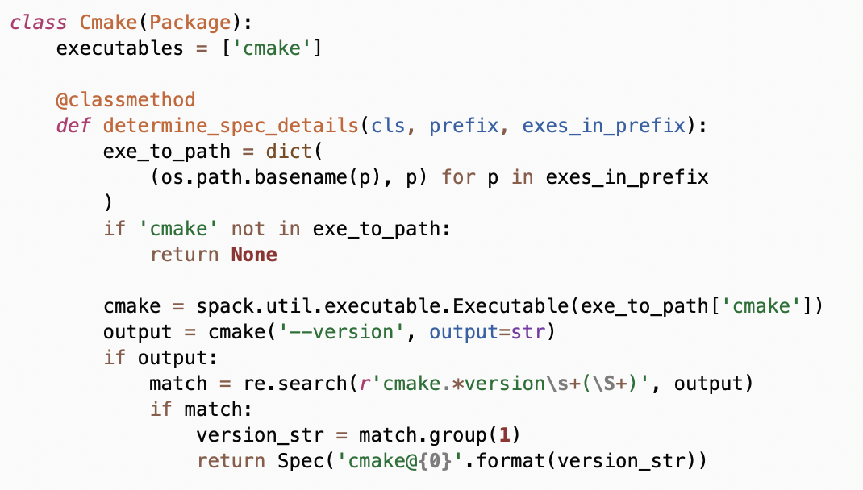
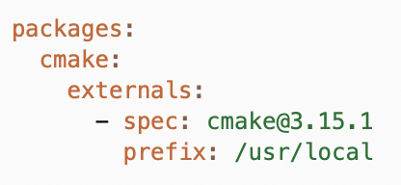
spack external find (new in v0.15, updated for 0.16)
Spack has has had compiler detection for a while
Finds compilers in your PATH
Registers them for use
We can find any package now
Package defines:
possible command names
how to query the command
Spack searches for known commands and adds them to configuration
Easily enable rapid setup of tools in an environment
Logic for finding external installations in package.py
packages.yamlconfiguration

Slide 19
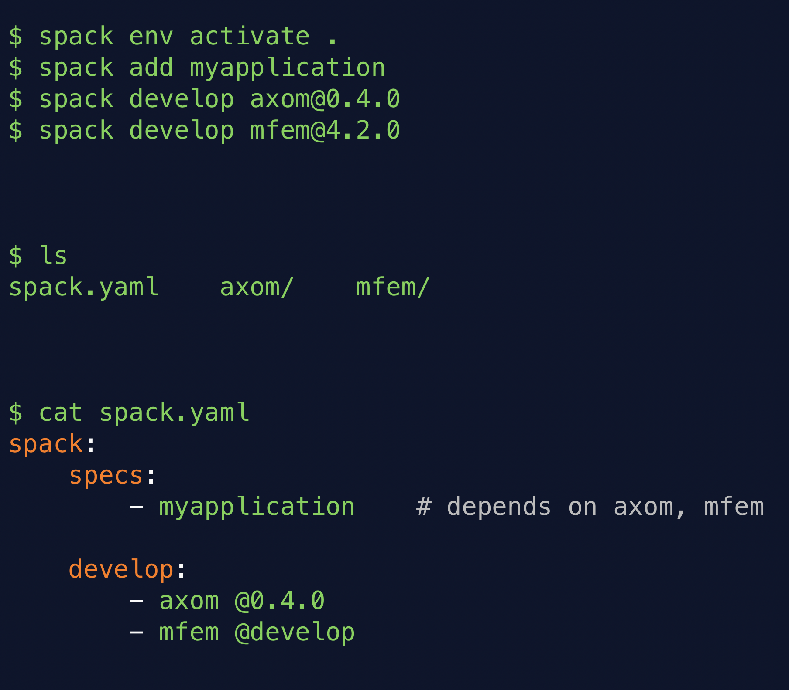
spack develop lets developers work on many packages at once
Developer features so far have focused on single packages (spack dev-build, etc.)
New spack develop feature enables development environments
Work on a code
Develop multiple packages from its dependencies
Easily rebuild with changes
Builds on spack envirnoments
Required changes to the installation model for dev packages
dev packages don’t change paths with configuration changes
Allows devs to iterate on builds quickly

Slide 20
Spack v0.18.0 was released at ISC in early June!
Major new features:
--reuse enabled by default
Reuse installed packages and build caches
Use spack install --fresh to get the old behavior
Finer-grained spec hash + provenance
Better error messages
Unify when possible in environments
Cray manifest support
Windows support
New binary format + hardened package signing
Bootstrap mirror generation (for air gaps)
Makefile generation
Conditional variant values and sticky variants
github.com/spack/spack
377 contributors to packages!
85 contributors to core!

Slide 21
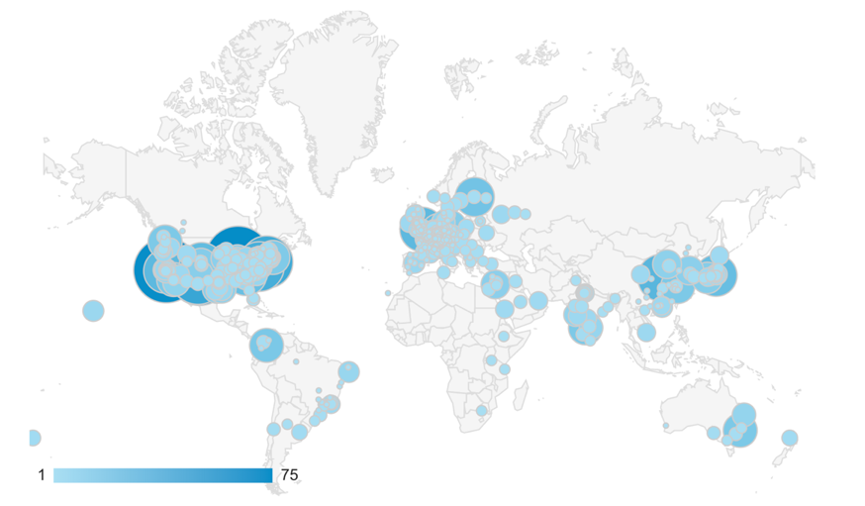
Concretization is at the core of Spack!
This problem is NP-hard!
Contributors
package.py repository
new versions
new dependencies
new constraints
concretizer
spack developers
default config
packages.yaml
yaml
admins, users
local preferences config packages.yaml
yaml
users
local environment config spack.yaml
yaml
Concrete spec is fully constrained
and can be built.
Command line constraints
users
spack install hdf5@1.12.0 +debug

Slide 22
Crash course in ASP
enable_some_feature.
node("lammps").
node("cuda").
variant_value("lammps", "cuda", "False").
depends_on("lammps", "cuda", "link").
ASP syntax is derived from Prolog
Basic piece of a program is a term
Terms can easily represent any data structure, e.g. this is a graph with:
2 nodes, one with a variant value
1 dependency edge
Terms followed by '.' are called facts
Facts say "this is true!"

Slide 23
Crash course in ASP
ASP programs also have rules.
Rules can derive additional facts.
:- can be read as "if"
The head (left side) is true
If the body (right side) is true
Comma in the body is like "and"
Writing same head twice is like "or"
Capital words are variables
Rules are instantiated with all possible substitutions for variables.
node(Dependency) :- node(Package), depends_on(Package, Dependency, Type).
node("cuda")
node("lammps"). depends_on("lammps", "cuda", "link").

Slide 24
Crash course in ASP
Constraints say what cannot happen
Choice rules give the solver freedom to choose from possible options:
path(A, B) :- depends_on(A, B).
path(A, C) :- path(A, B), depends_on(B, C).
:- path(A, B), path(B, A). % this constraint says "no cycles"
% if a package is in the graph, solver must choose exactly one version % out of that package's possible versions
1 { version(V) : possible_version(Package, V) } 1 :- node(Package).
% if a package is in the graph, solver must choose exactly one version % out of that package's possible versions
1 { version(V) : possible_version(Package, V) } 1 :- node(Package).
% if a package is in the graph, solver must choose exactly one version % out of that package's possible versions
1 { version(V) : possible_version(Package, V) } 1 :- node(Package).
% if a package is in the graph, solver must choose exactly one version % out of that package's possible versions
1 { version(V) : possible_version(Package, V) } 1 :- node(Package).
% if a package is in the graph, solver must choose exactly one version % out of that package's possible versions
1 { version(V) : possible_version(Package, V) } 1 :- node(Package).

Slide 25
ASP searches for stable models of the input program
Stable models are also called answer sets
A stable model (loosely) is a set of true atoms that can be deduced from the inputs, where every rule is idempotent.
Similar to fixpoints
Put more simply: a set of atoms where all your rules are true!
Unlike Prolog:
Stable models contain everything that can be derived (vs. just querying values)
ASP is guaranteed to complete!

Slide 26
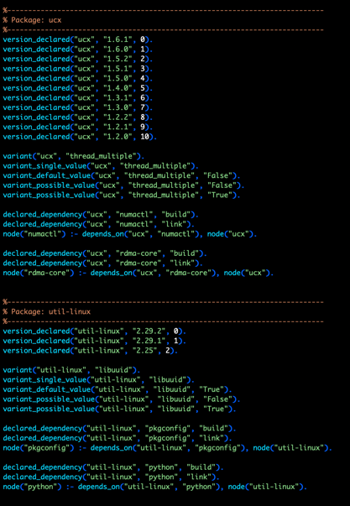
Spack’s concretizer is now implemented in ASP
Used Clingo, the Potassco grounder/solver package
ASP program has 2 parts:
Large list of facts generated from package recipes (problem instance)
60k+ facts is typical – includes dependencies, options, etc.
Small logic program (~700 lines of ASP code)
Algorithm (the part we write) is conceptually simpler:
Generate facts for all possible dependencies
Send facts and our logic program to the solver
Rebuild a DAG from the results
Some facts for HDF5 package

Slide 27
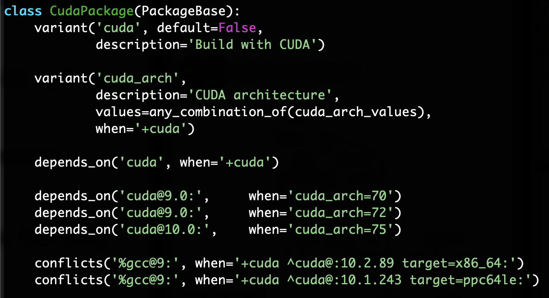
Spack DSL allows declarative specification of complex constraints
CudaPackage: a mix-in for packages that use CUDA
cuda is a variant (build option)
cuda_arch is only present if cuda is enabled
dependency on cuda, but only if cuda is enabled
constraints on cuda version
compiler support for x86_64 and ppc64le
There is a lot of expressivity in this DSL.

Slide 28
Many packaging systems reuse builds via metadata hashes
Hash matches are very sensitive to small changes
In many cases, a satisfying cached or already installed spec can be missed
Nix, Spack, Guix, Conan, and others reuse this way
1. Resolve metadata
2. Create per-node hashes
cwx4qwk4bkamf4gjrglmxfu3bhasyt74
qo2af23r2npatxdtna3fmwkeennywixp
k2yumgxwq6ijubivfpbjpmrrbzyqcoot
Package cache
4xxvh5ldm7gm32ngtixcm2odaer3cvvb
74mwnxgn6nujehpyyalhwizwojwn5zga
??
6zvh4ueem6f5yrcfugh67k2hrtxbgbcs
3. Query for exact hash match

Slide 29
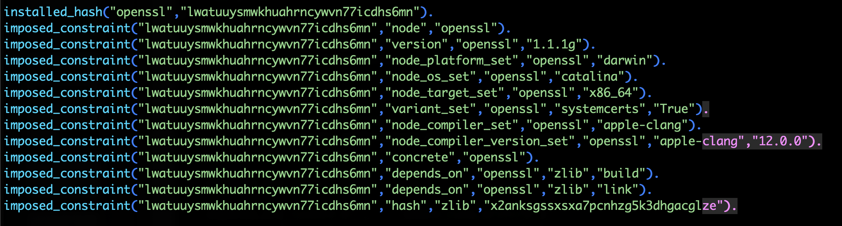
We can be more aggressive about reusing packages.
First, we need to tell the solver about all the installed packages!
Add constraints for all installed packages, with their hash as the associated ID:

Slide 30
Telling the solver to minimize builds is surprisingly simple: it's just the impose half of a generalized condition.
1. Allow the solver to choose a hash for any package:
2. Choosing a hash means we impose its constraints:
3. Define a build as something without a hash:
4. Minimize builds!

Slide 31
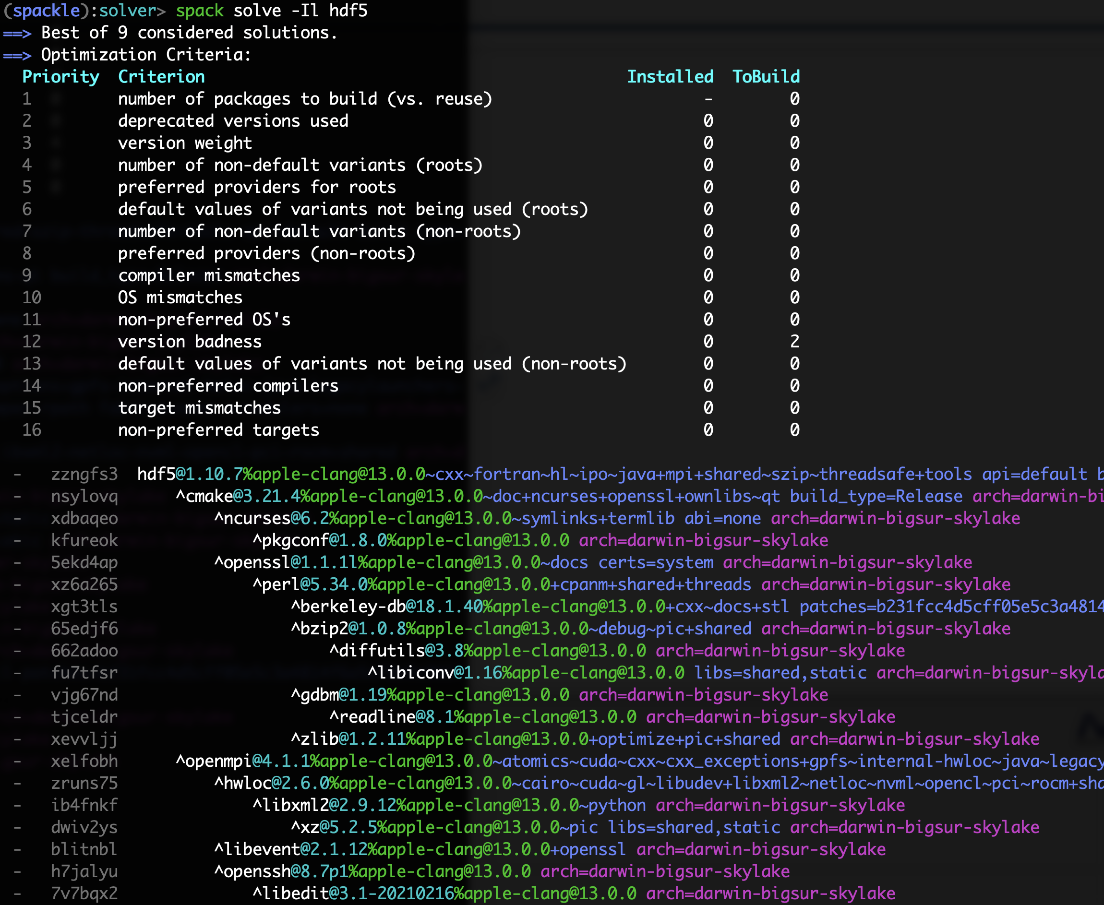
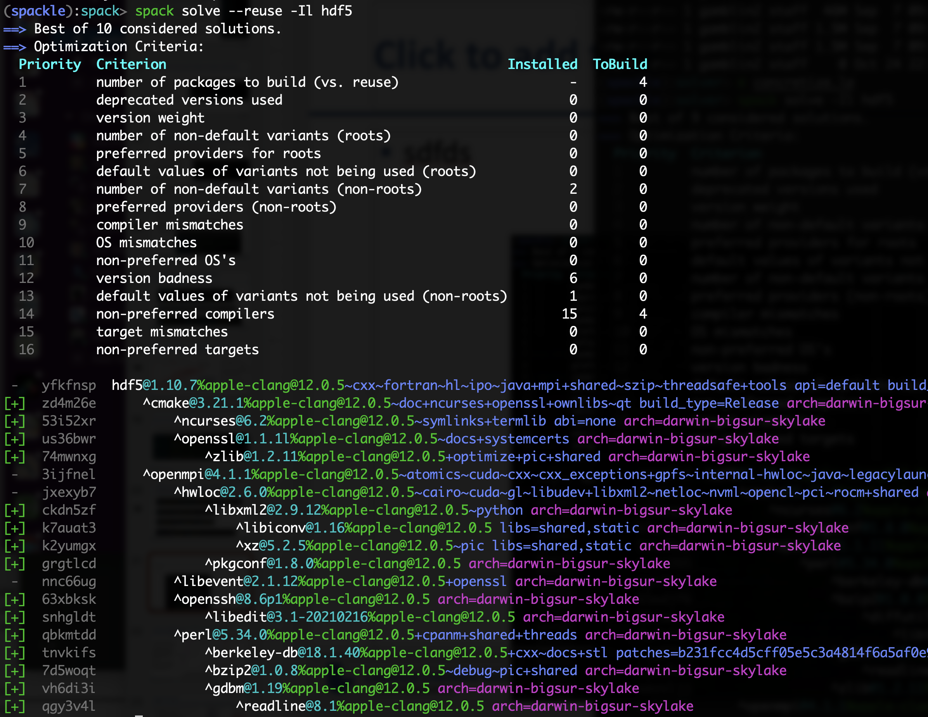

With and without reuse optimization
Note the bifurcated
optimization criteria
Pure hash-based reuse: all misses
With --reuse: 16 packages were reusable

Slide 32
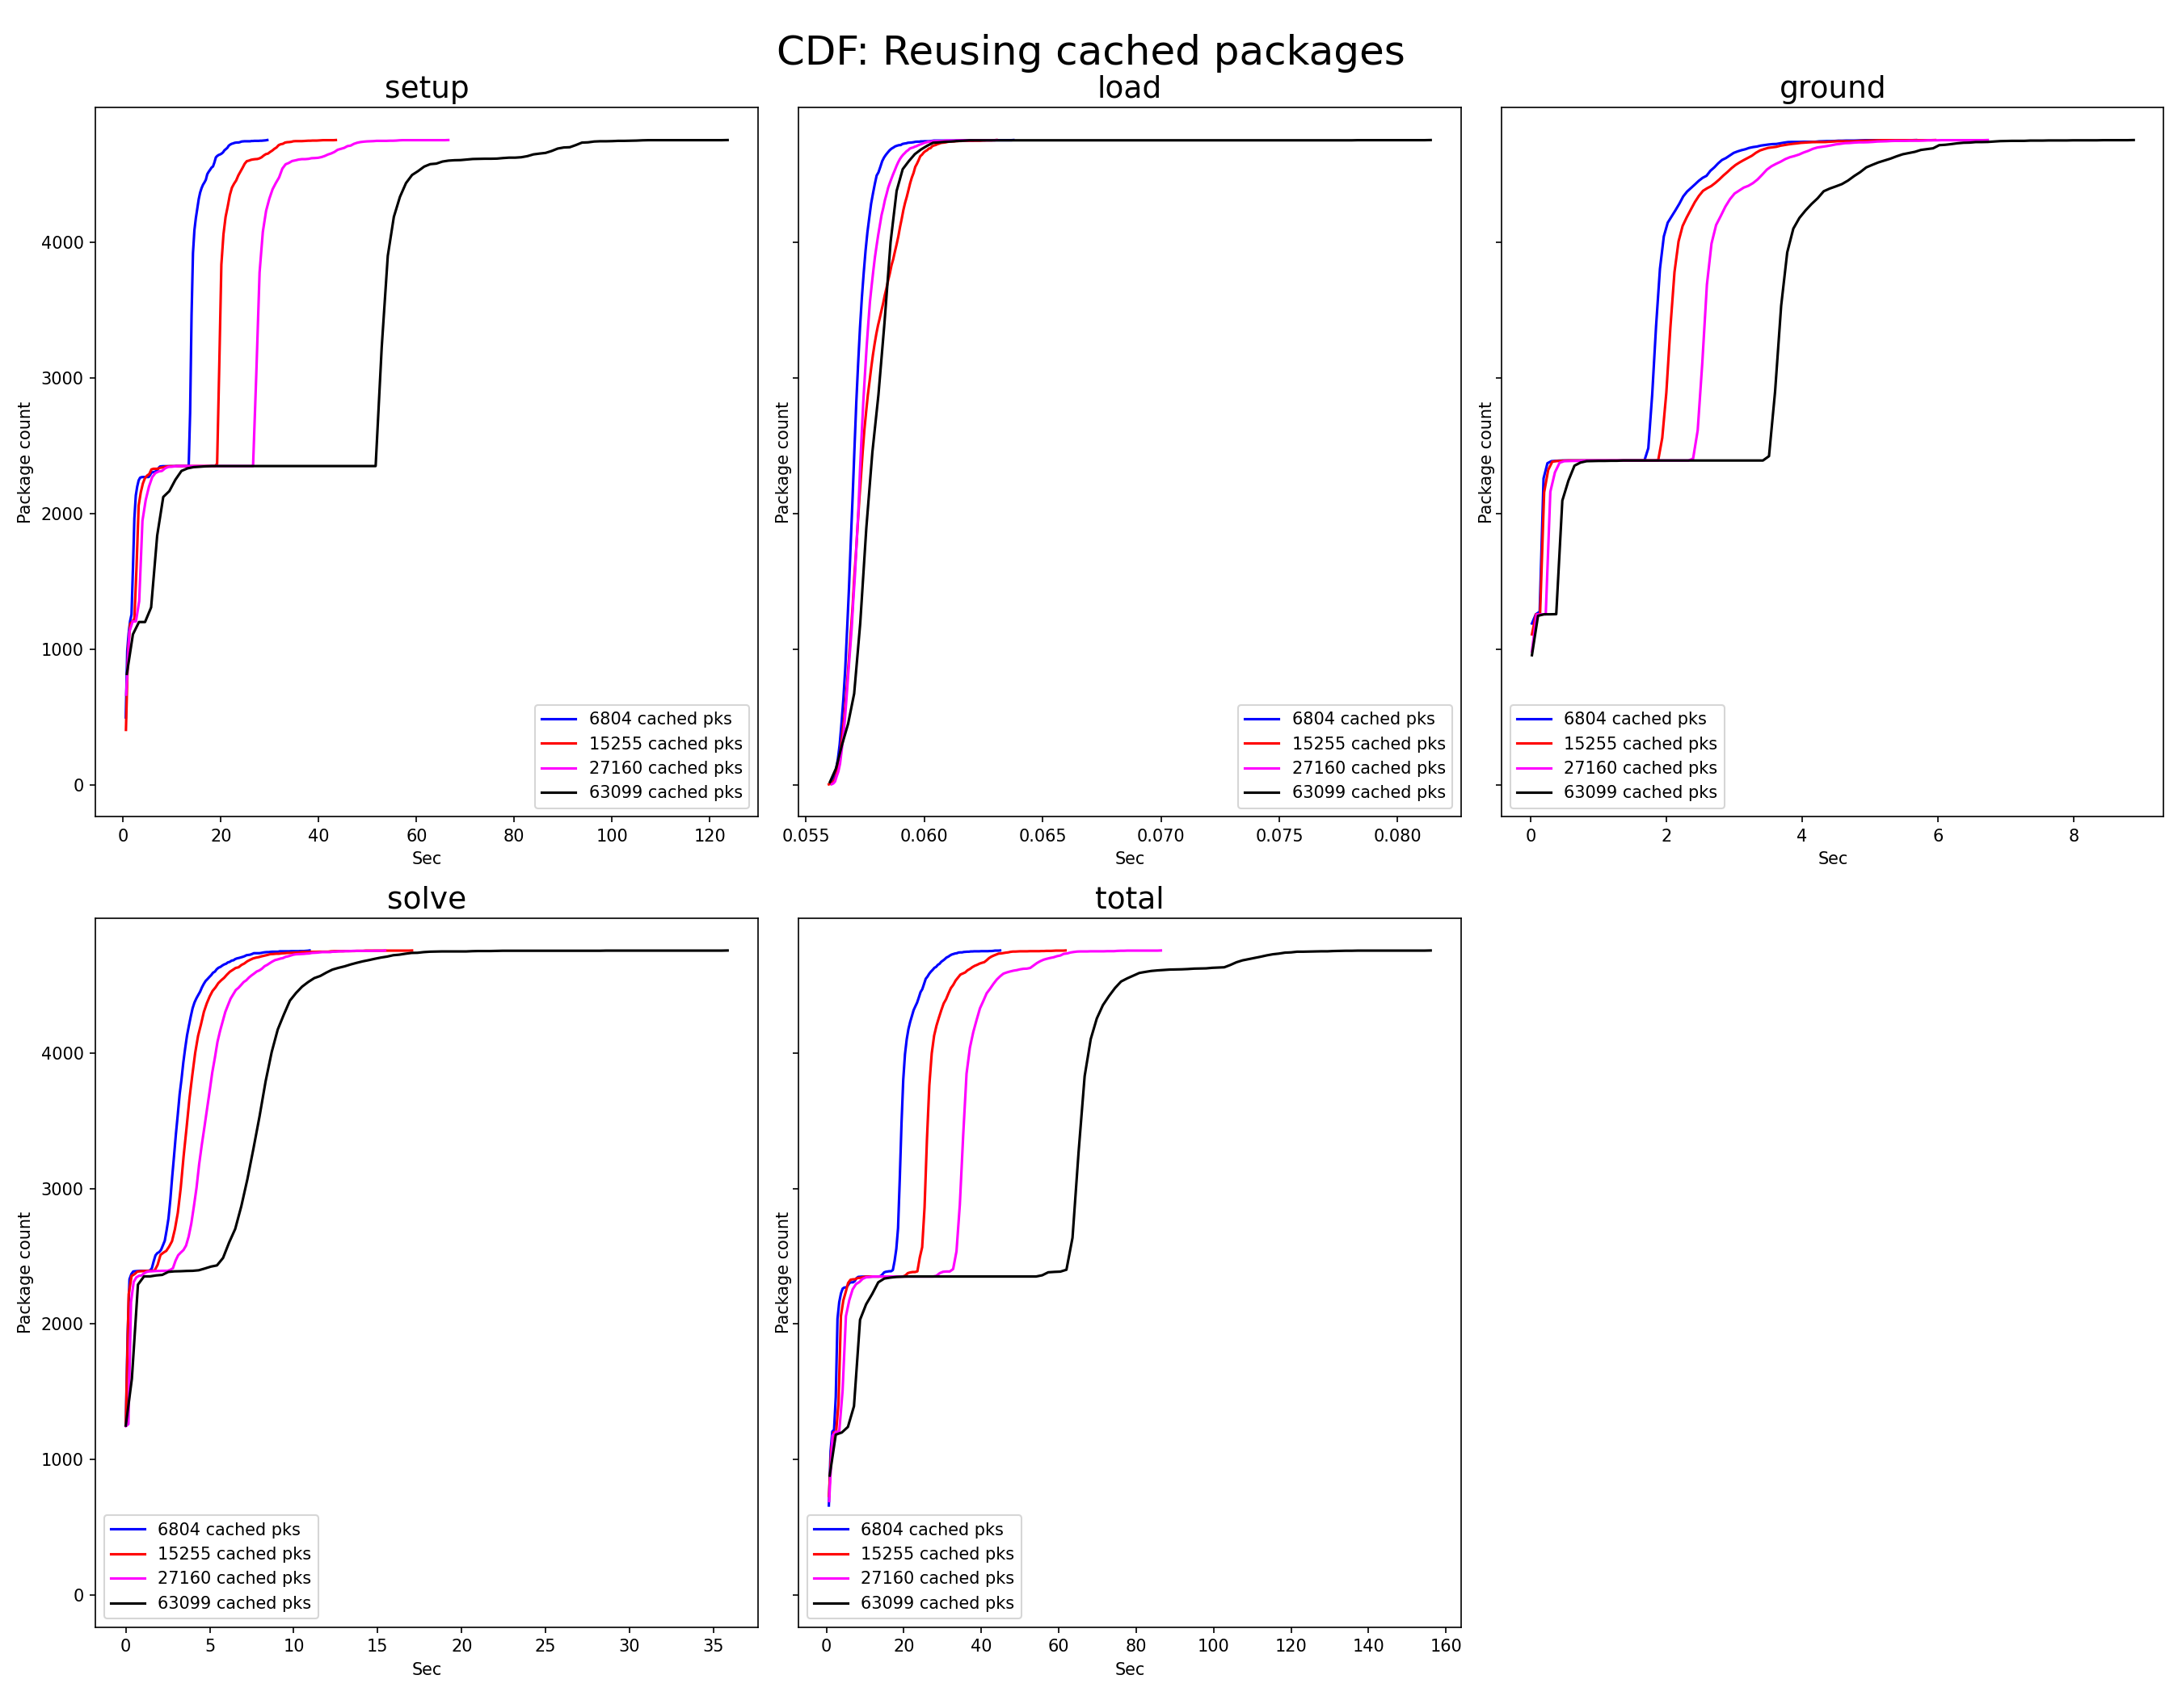
So far, it looks like we can handle very large problem sizes with the reusing solver
Cumulative distribution of setup and solve times
Hypothesis: we don’t see big combinatorial blow-up b/c we're strict about dependency hashes
Next: try mixed ABI, but prefer "pure" source-built dependencies
Most of the time is spent in setup (reading data in Python – can be sped up w/caching)
Even with 63k packages in a repo, nearly all package solves take < 10 sec

Slide 33
What does the Spack project look like?
E4S
AWS
LLNL stack
xSDK
xSDK
App
External Stacks
. . .
Spack Community 💁‍♂️ 💁🏾 💁 💁🏻‍♀️ 💁🏻 💁🏾‍♂️ 💁🏻‍♂️ 💁‍♀️ 💁🏼‍♂️ 💁🏾‍♀️ 💁🏼 💁🏽‍♀️ 💁🏽‍♂️ 💁🏽 💁🏼‍♀️ 💁🏼‍♂️
Infrastructure
Package Recipes
Core tool (CLI + Solver)

Slide 34

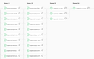
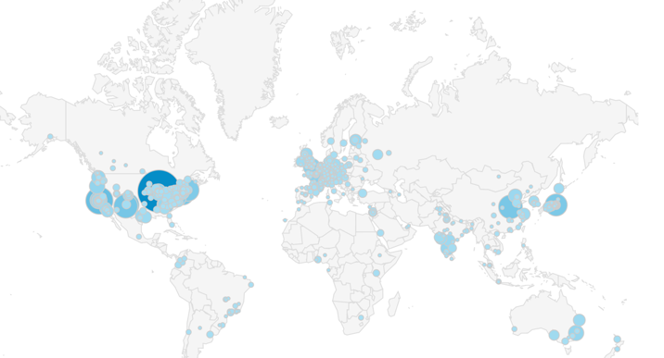



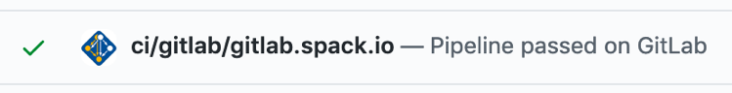
CI has made Spack builds much more reliable!
Spack Contributions
on GitHub (over 1,000 contributors)
gitlab.spack.io
x86_64 and aarch64 pipelines in AWS
ppc64le, GPU pipelines at U. Oregon
spack ci
Pipelines at LLNL (Cray PE soon)
spack.yaml configurations
(E4S, SDKs, AWS, others)
GitLab CI builds (changed) packages
On every pull request
On every release branch
Do users really need to build from source?

Slide 35
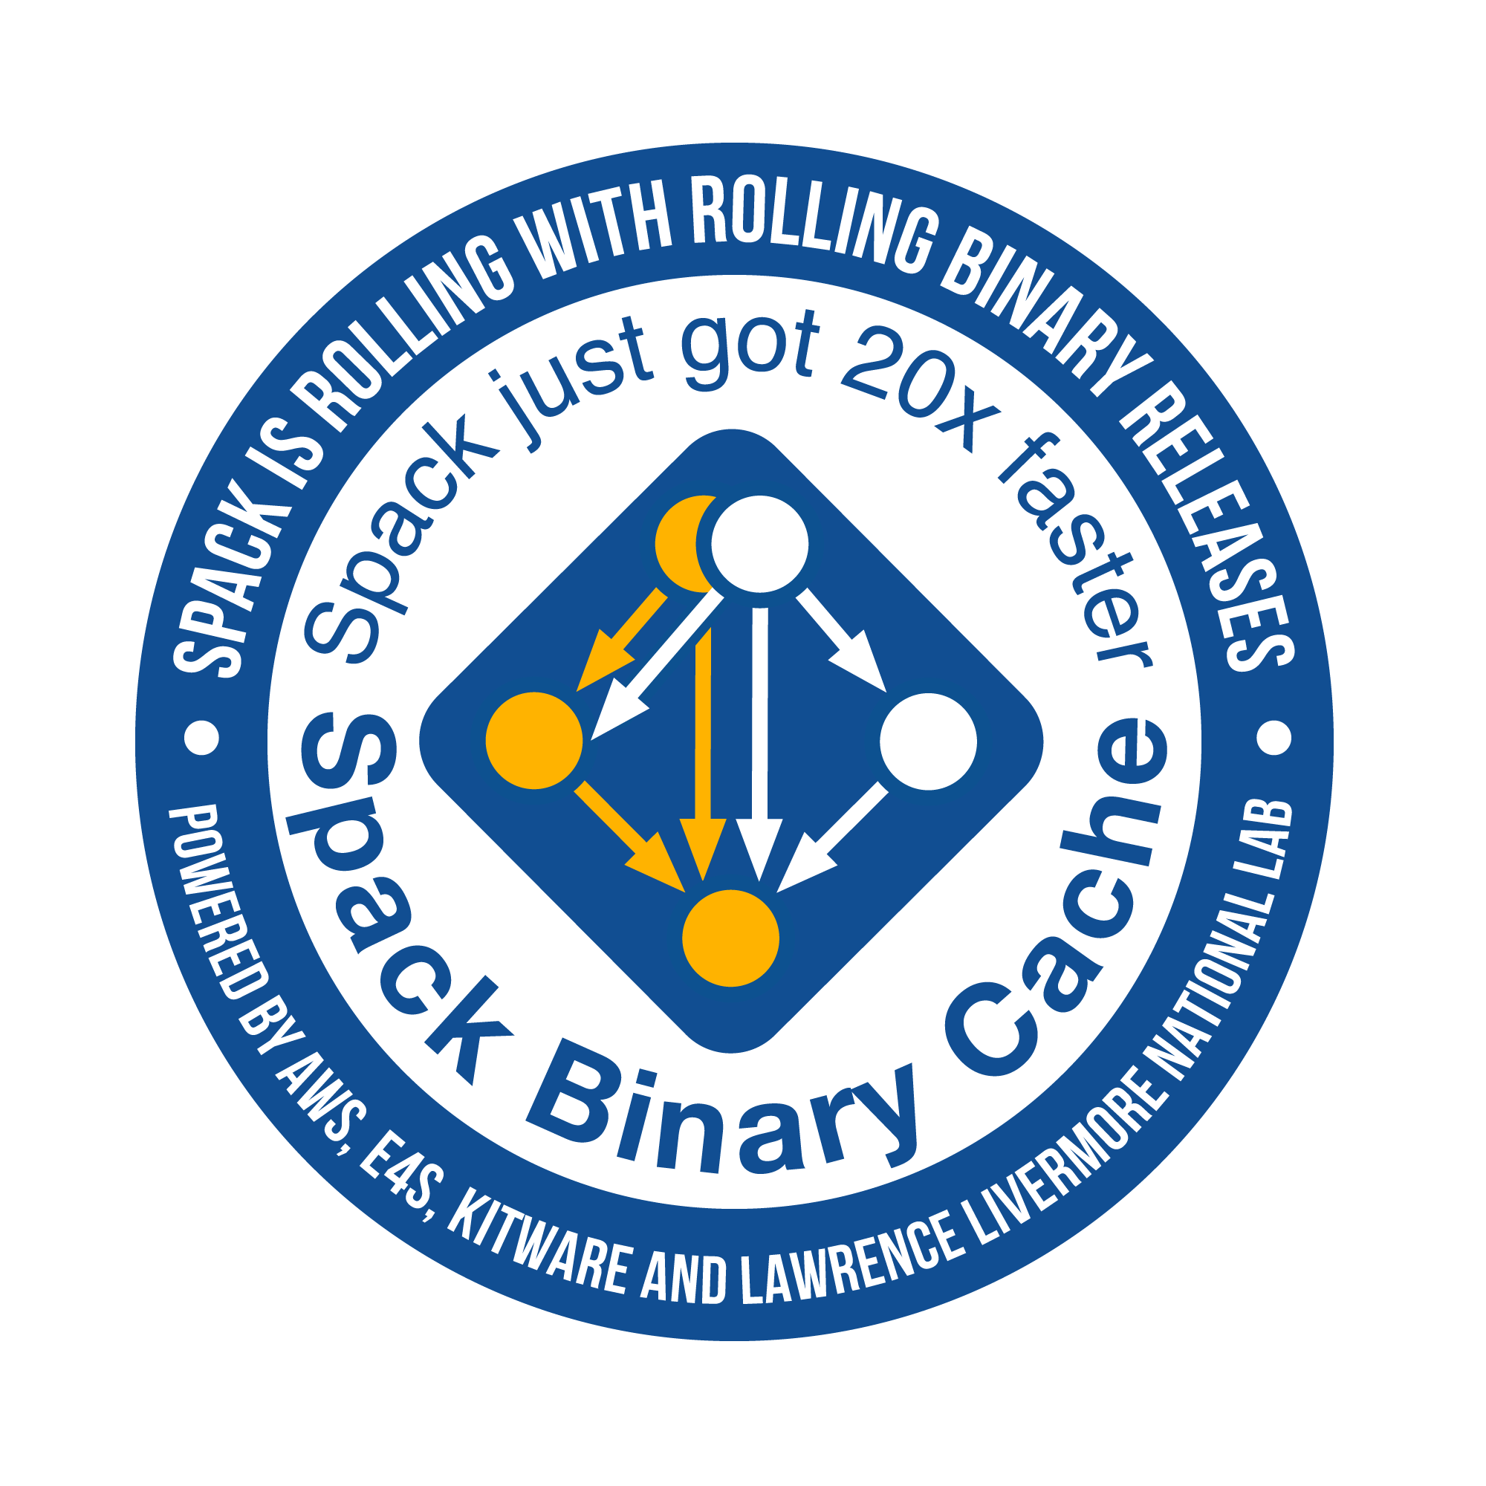


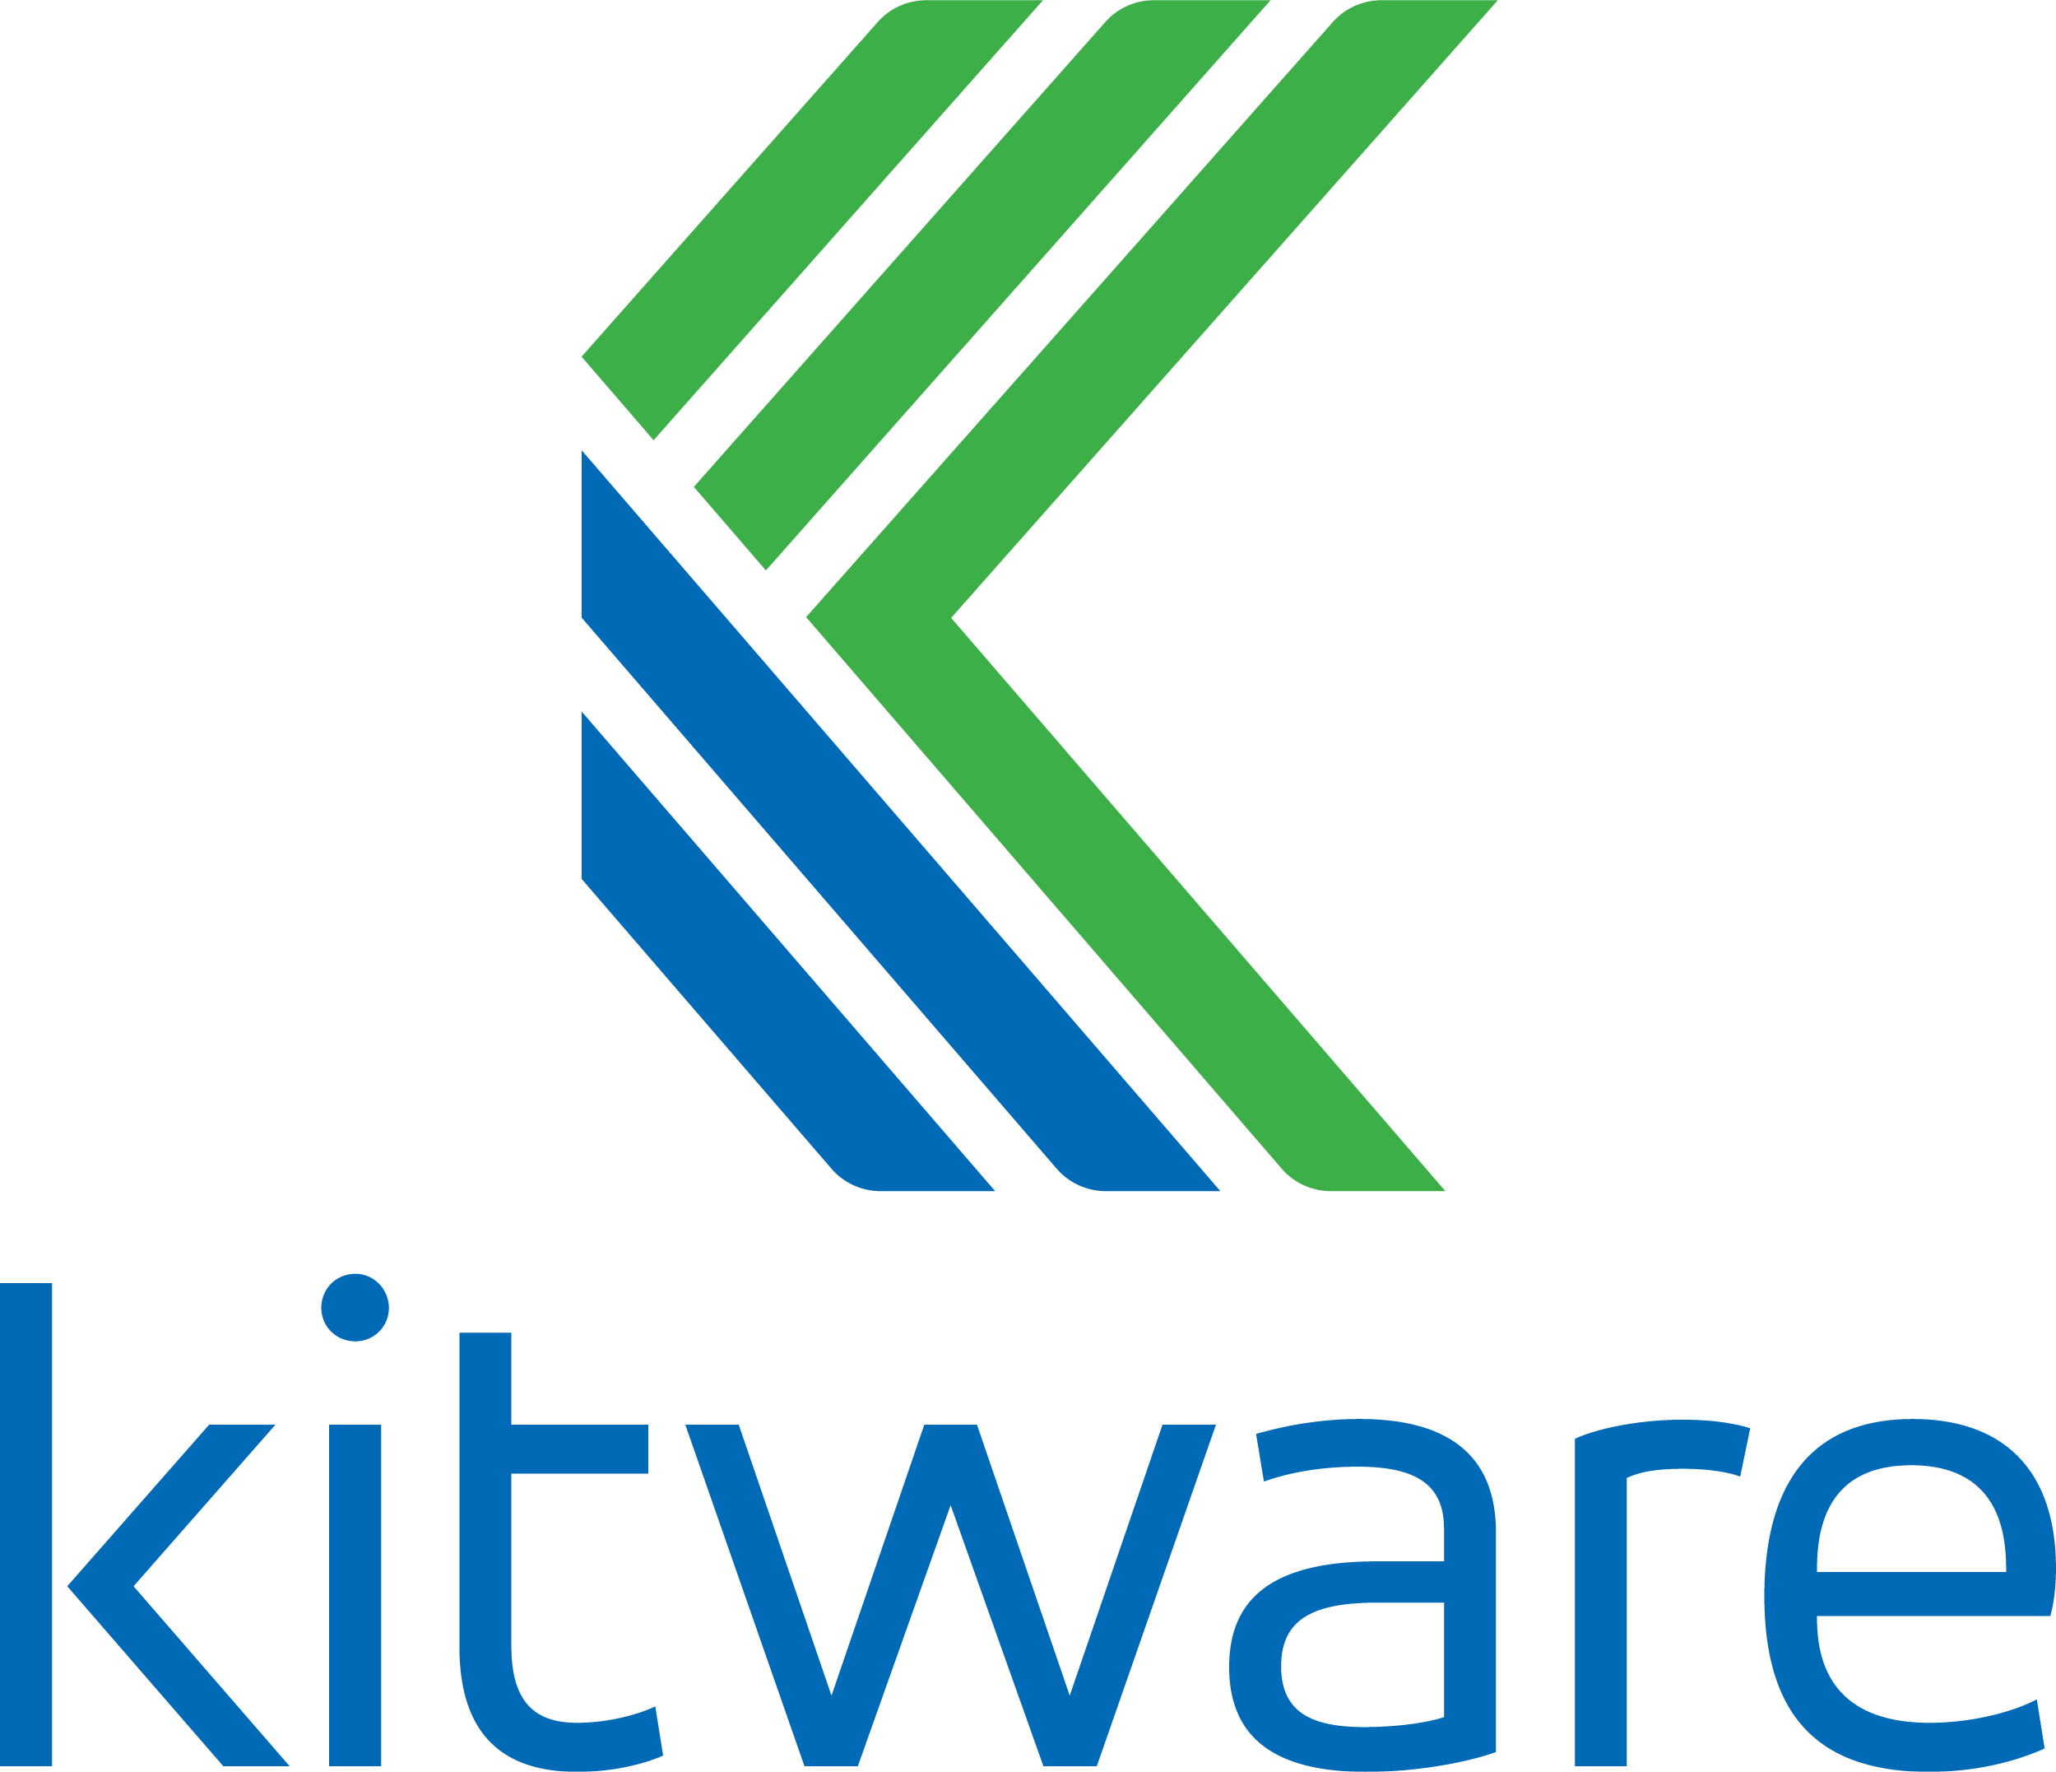

With v0.18, Spack has a public binary cache
# latest v0.18.x release binaries
spack mirror add https://binaries.spack.io/releases/v0.18
# rolling release: bleeding edge binaries
spack mirror add https://binaries.spack.io/develop
Over 3,000 builds in the cache so far:
Amazon Linux 2 x86_64_v4
Amazon Linux 2 aarch64
Amazon Linux 2 graviton2
Ubuntu 18.04 x86_64
Do we trust binaries?

Slide 36




We aim to lower the burden of maintaining a binary distribution and make it easy to mix source builds with binaries.
Traditional package manager
Portable (unoptimized) x86_64 binaries
One software stack upgraded over time
Recipe per package configuration (need rewrites for new systems)
Build farm
Optimized Graviton2 binaries
Many software stacks
Built for specific: Systems Compilers OS’s MPIs etc.
Optimized Skylake binaries
Spack
Parameterized recipe per package
(Same recipe evolves for all targets)
Build farm / CI
Optimized GPU binaries
Users/developers can also build directly from source

Slide 37
Our infrastructure enables us to sustainably manage a binary distro
Separate, untrusted S3 buckets
Public, signed binaries in CloudFront distribution
Per-PR build caches
https://binaries.spack.io
github/pr-28468
github/pr-28469
develop
releases/v0.18
…
…
Contributors submit package changes
Maintainers review PRs
Rebuild and Sign
Iterate on builds in PR
Caches prevent unnecessary rebuilds
Verify PR build succeeded
Review package code
Protected signing runners
Ephemeral keys
Merge to develop
Published binaries built ONLY from approved code
Moves bulk of binary maintenance upstream, onto PRs
Production binaries never reuse binaries from untrusted environment

Slide 38
Why should we care about this for our HPC codes?
LLNL ARES
Our codes use a lot of external software
Most packages are external open source
Many LLNL packages are also open source and developed in the open
We cannot replace all these OSS components with our own
How do we vet all these components?
Key question: Who/what do you trust to validate the components?
Current processes are not scalable and not automated!
30
12
71

Slide 39
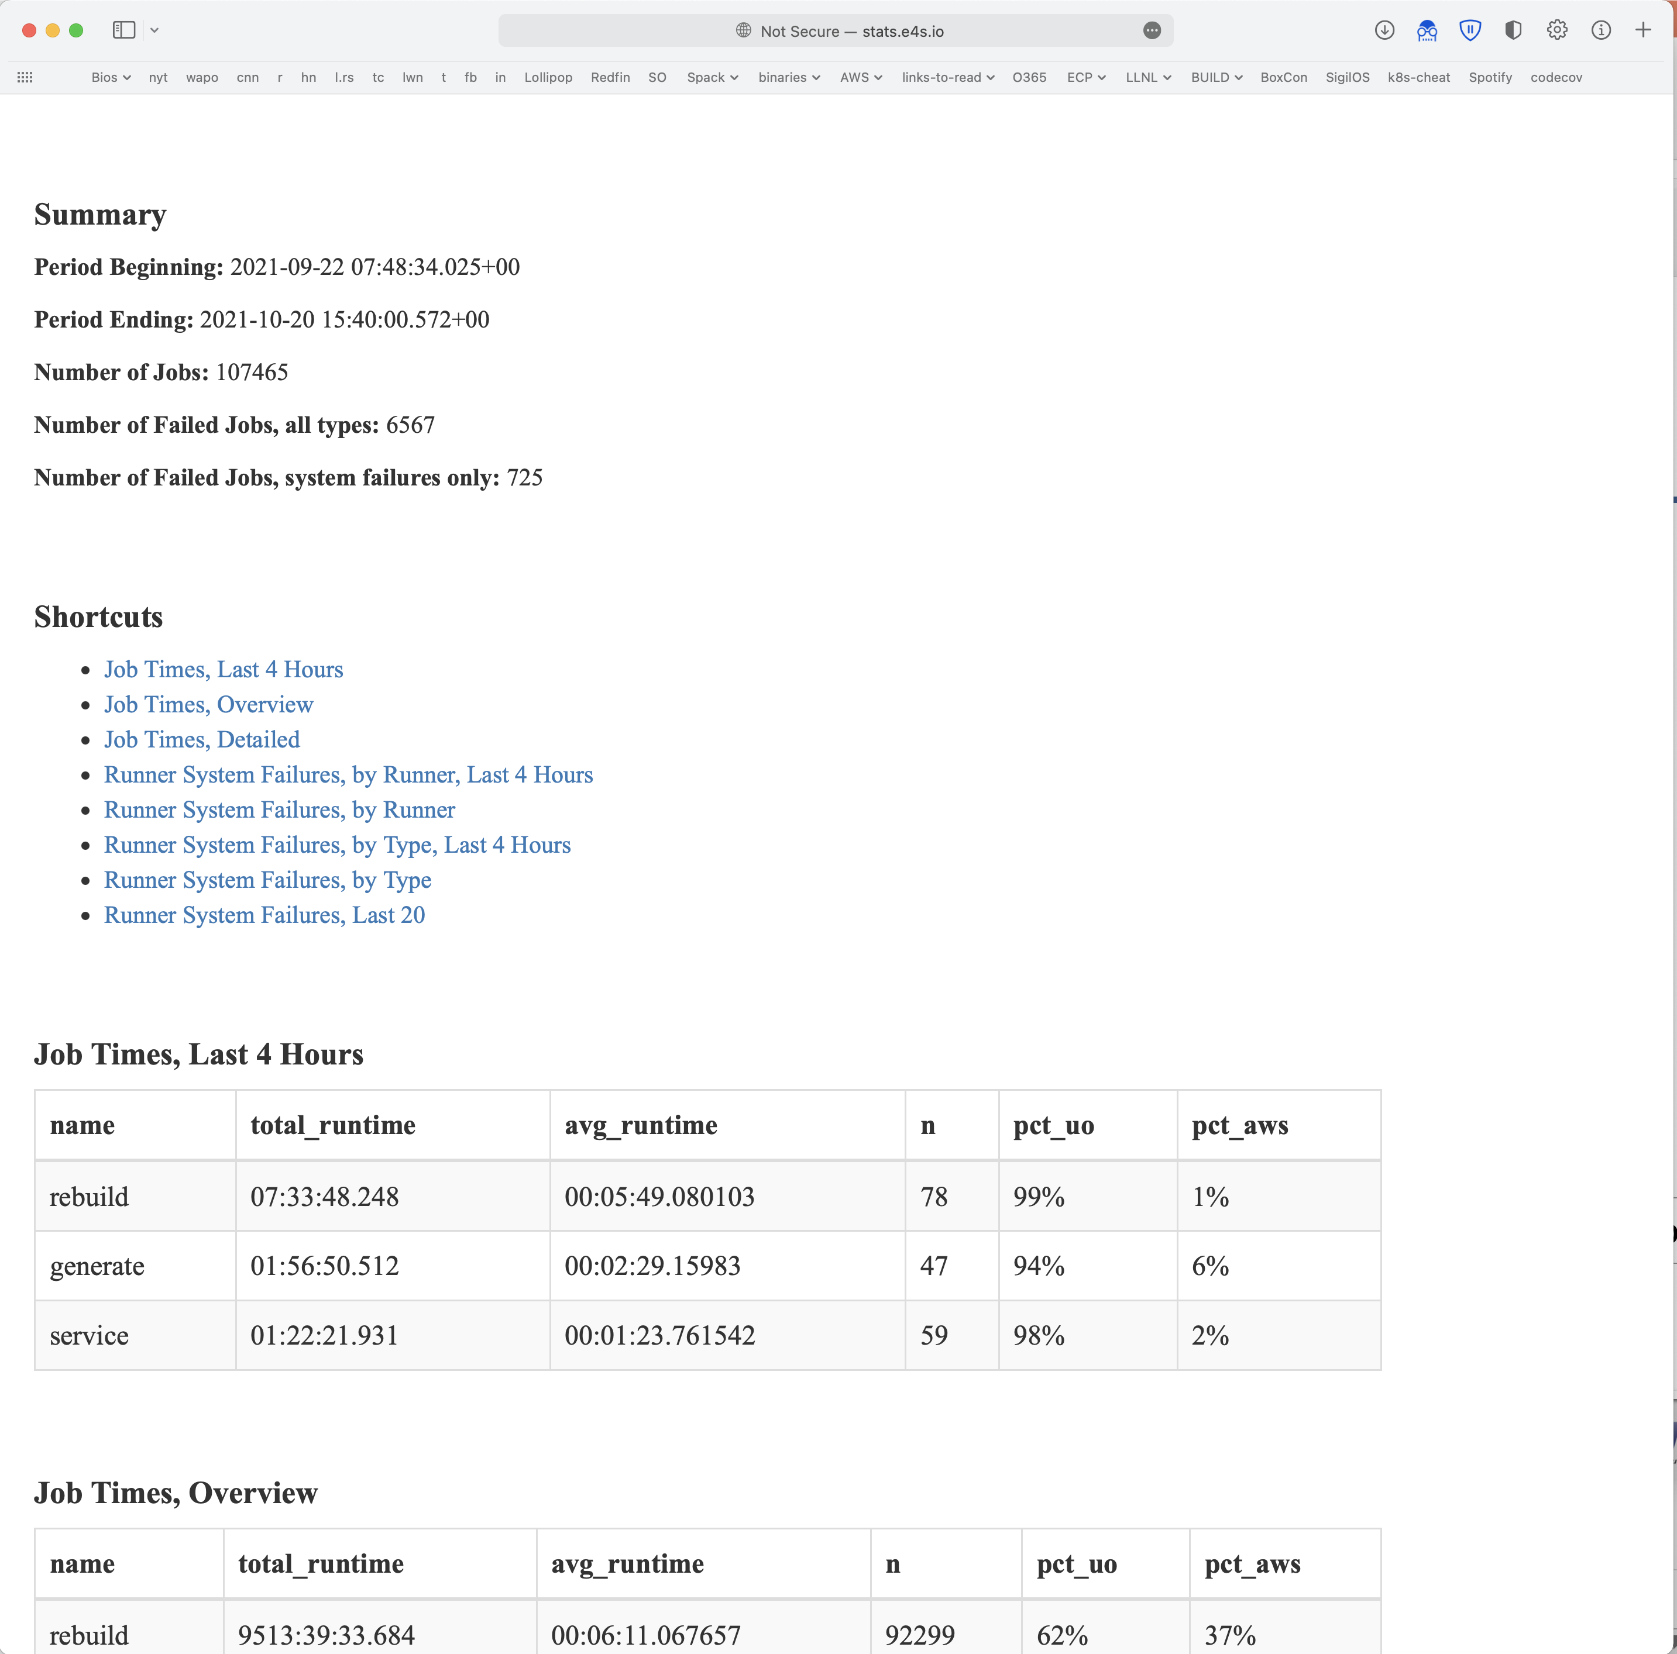
We will continue scaling this infrastructure out!
We are doing 40k builds per week!
There are lots of optimizations left to do on the build pipelines
We think we can eventually scale to all 6,400 Spack packages
Goal: make source builds unnecessary for most users
Source builds are optimized for x86_64_v4 (avx512), graviton, etc.
Source builds will still be seamless – key for reproducibility
Use spack develop to tweak (almost) any binary you can install
We will keep scaling OS, compiler, and arch support
Current crop of compilers and OS’s is a bit old – expect a refresh
Cray PE build coming soon!
Amazon Linux 2 builds work on AWS ParallelCluster NOW!
Build stats at
https://stats.e4s.io

Slide 40




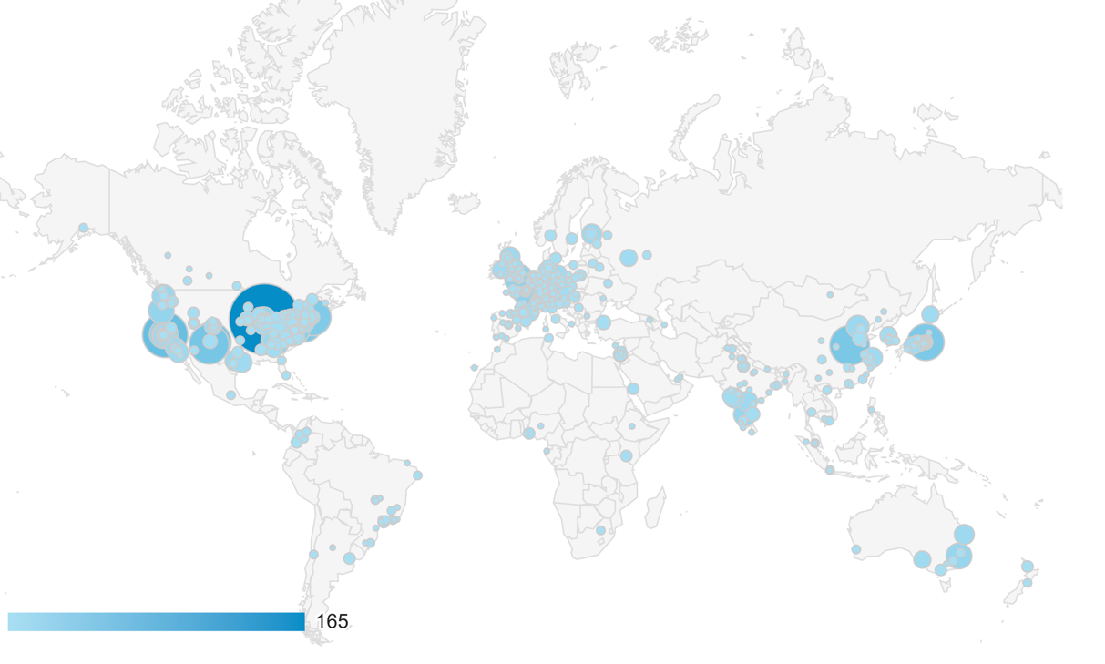

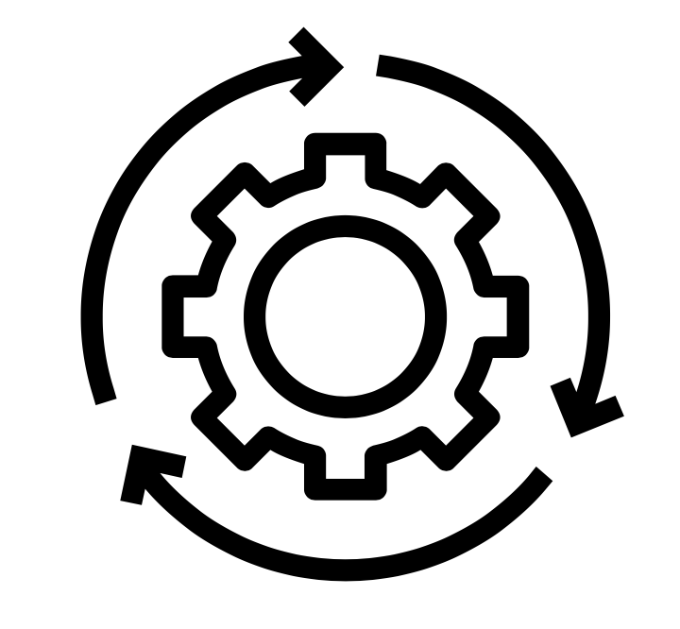



A Notional Secure Pipeline
Binary Packages
Open Source Contributions
Tarballs, other sources
Git commits
Verify
Scan
Build
Sign
Scan
Deploy
Container Images
Spack has 6,500 packages, with many updates per day.
Container Build
Sign
Verify
We are working to establish a set of guidelines for supply chain integrity
Labs are trending towards GitLab, Spack for HPC
Standard container formats can help with scanning
Standard SBOM format could help sites cross-validate codes
Spack can help to standardize some of this.

Slide 41













Spack’s long-term strategy is based around broad adoption and collaboration
Not sustainable without a community
Broad adoption incentivizes contributors
Cloud resources and automation absolutely necessary
Preserves build knowledge in a cross-platform, reusable way
Minimize rewriting recipes when porting
CI ensures builds continue to work as packages evolve
Keep packages flexible but verify key configurations
Growing contributor base and automation are the top priorities
377 contributors to 0.18 release!
Spack Community

Slide 43
What is software supply chain?
Everything needed to develop, build, and publish a software artifact:
Components
Libraries
Tools
Processes
Software Bill of Materials (SBOM): a new term you’ll hear a lot of
Analogous to BOM from hardware supply chain
“Nutrition label” for Software
Listing of all software components in a product
Several formats exist
SPDX, CycloneDX are the major ones
Tooling is still limited
Not exactly a small set of things!

Slide 44
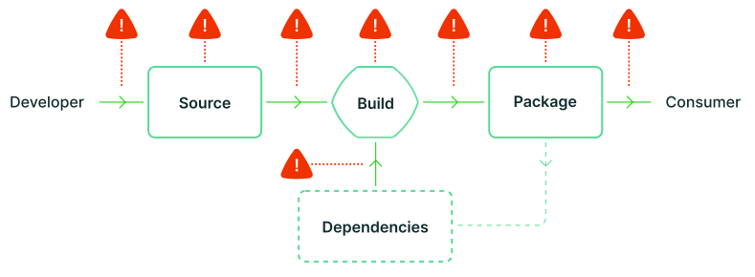
Why do we care?
Software is increasingly composed of many independently developed components
Development process involves many automated (or not) systems
CI/CD
Code hosting
Package managers
How do you know that all components/processes do what you expect?
Image from slsa.dev
There are many potential points of compromise!

Slide 45
We are working with code teams to develop standard workflows for layered build farms
We are working with the MARBL team to move their development environment to Spack
We have established a build and deployment working group among WSC codes
We aim to put together an L2 milestone for next year to:
Make a common build farm for WSC codes
Layer with Spack’s public build farm
Gradually bring teams together around standard build configurations and workflows
llnl.wci.mapp
marbl
blast
miranda
MARBL Packages
Common WSC packages
llnl.wci
leos
builtin
Mainline Spack packages
boost
raja
axom

Slide 46
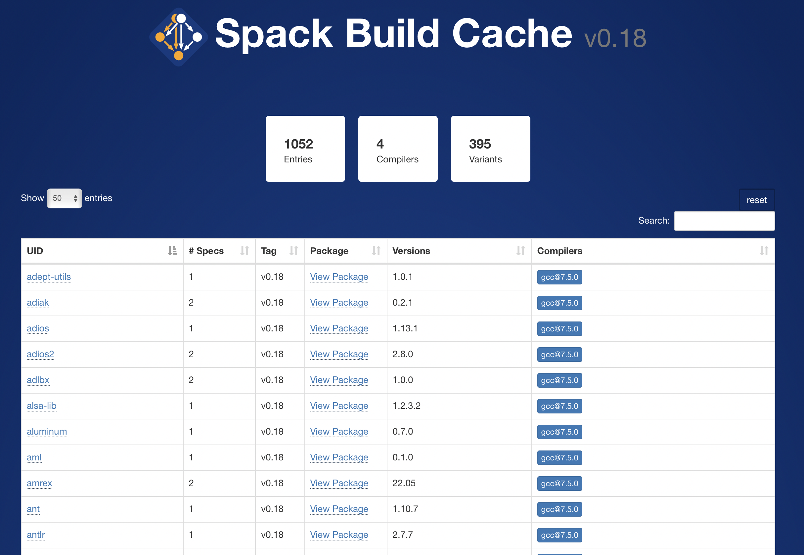
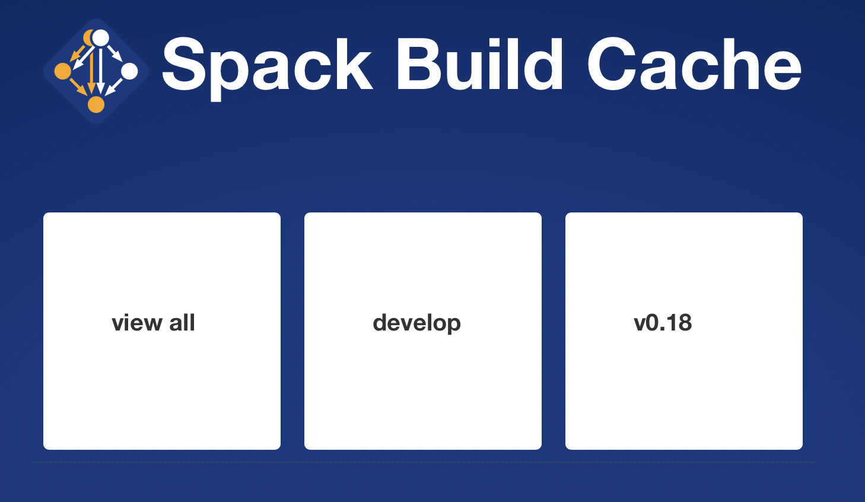
You can browse the cache at https://cache.spack.io
Choose your release
Search binaries in the cache
Awesome browser UI thanks to Vanessa Sochat! (@vsoch)

Slide 47
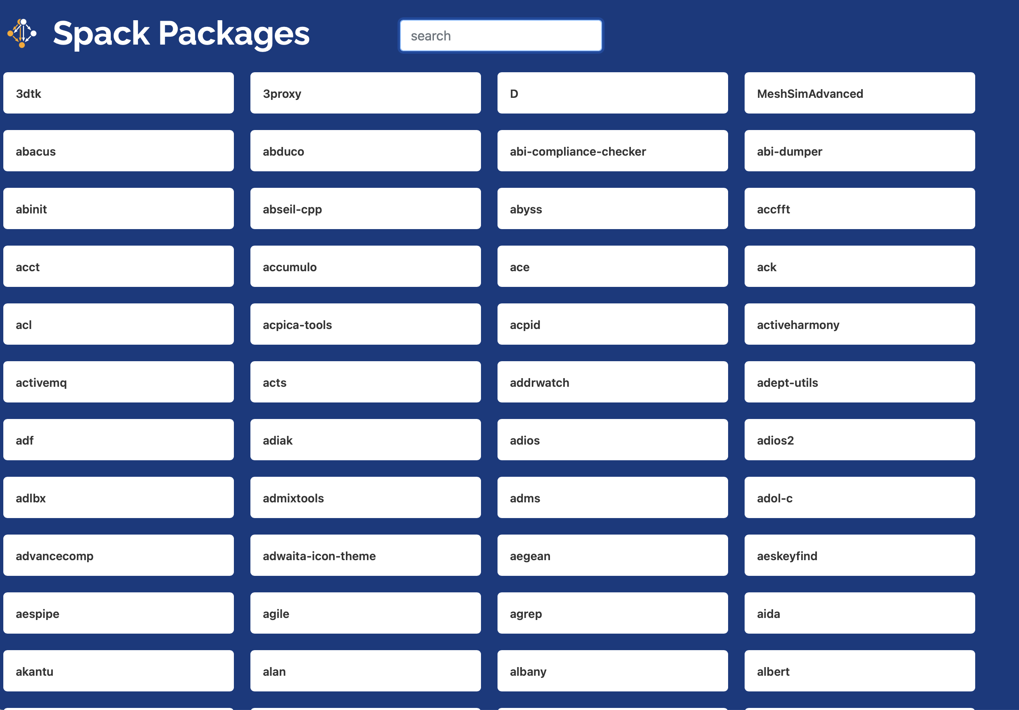
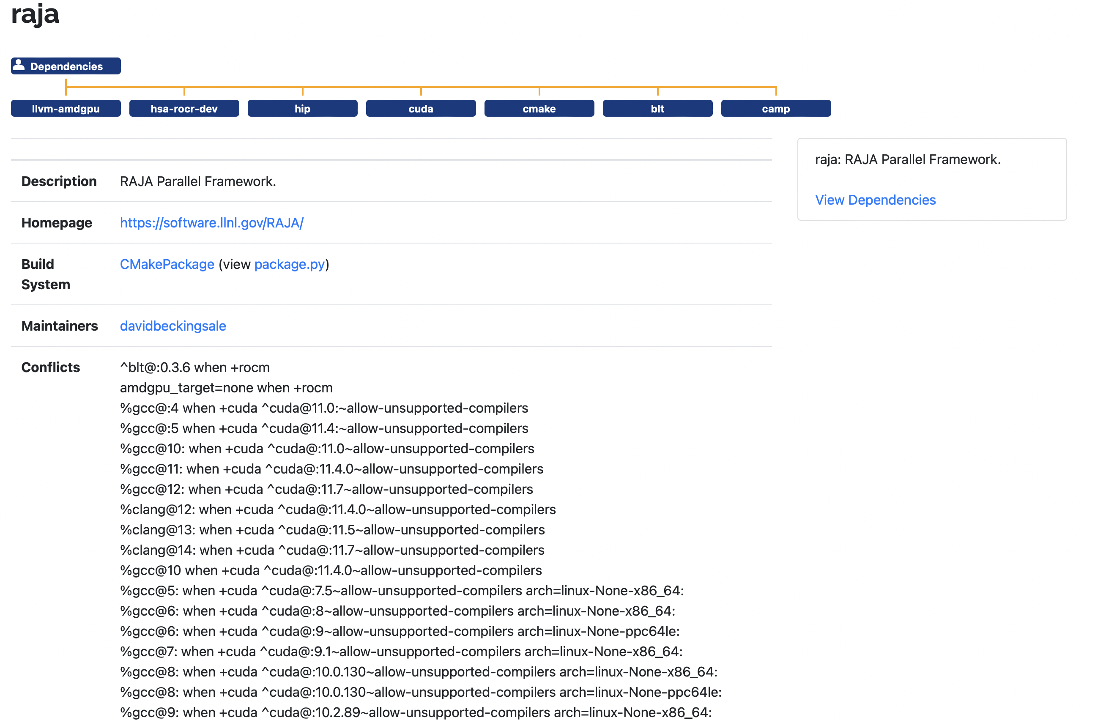
Binary browser cross-references to our new package browsing UI!
https://packages.spack.io
Search all 6,400+ packages
Fast loading page
Previous packages list was getting very slow
Way faster!
Details on versions, dependencies, conflicts, variants, etc.
Awesome browser UI thanks to Vanessa Sochat! (@vsoch)

